Slide 1


PM2.5 air pollution and cause-specific
cardiovascular disease mortality
Significant Paper Presentation -CMPE255 Data Mining
By Team 7
Jeyasri Subramanian
Subarna Chowdhury Soma
Manmeet Singh
Pranav Lodha

Slide 2
Significant Paper Summary
International Journal of Epidemiology,
Published in: 23rd May, 2019
Journal's impact factor: 7.339

Slide 3
Index
Abstract
Terms
Data Collection
Data Modeling
Results and graphs
Our Understanding
Conclusion

Slide 4
Abstract
Evaluate risks for cause-specific cardiovascular disease (CVD) mortality in a cohort (USA)
Investigate whether health risk is independent of Races/Ethnicities
Statistically analyze whether long-term exposure to fine particulate air pollution leads to premature death caused by ischaemic heart disease(IHD) and stroke
Notes:
Cardiovascular diseases-ischaemic heart disease and stroke mortality
-with excess CVD risks occurring in the range of and below the present US long-term standard for ambient exposure to PM2.5 (12 mg/m3).
PM2.5 is associated with increased risk for IHD and stroke mortality, with excess CVD risks occurring in the range of and below the present 12 lg/m3 annual average standard for the USA for PM2.5

Slide 5
AQI
Notes:
You can explain PM here :
Composition of Air Pollution • Air pollution consists of aerosols containing a mixture of both particles and gases • Particulate matter (PM) is easily measured and readily relatable to the adverse health effects • PM stands for particulate matter (also called particle pollution) • mixture of solid particles and liquid droplets found in the air • PM10 : inhalable particles, with diameters that are generally 10 micrometers and smaller • PM2.5 : fine inhalable particles, with diameters that are generally 2.5 micrometers and smaller. 11/4/2018 7Braunwald Heart disease, 11th edition, Chapter 52 Air Pollution and Cardiovascular Disease

Slide 6
Data Collection
National Institutes of Health-AARP: survey on 565, 477 men and women, aged from 50 to 71 years
Data on ischemic heart disease (IHD) and 5894 stroke deaths (National Death Index)
PM2.5 was estimated using a hybrid land use regression (LUR) geostatistical model

Slide 7
Data Modeling
Cox Regression modelling is a time variant regression model applied to predict the effect of PM2.5 on Cardio Vascular Disease(CVD) mortality
Key Features
Hazard Ratio (HR)
PM2.5
95% confidence intervals for CVD Mortality
Models were also fitted in relation to selected categories of exposure [<8 mg/m3 (referent), 8 -<12 mg/m3, 12-<20 mg/m3, 20þ mg/m3].
Additional features
Gender
Religion
Age
Ethnicity
In addition to this, characteristics of Sensex based data such as median income, percentage not completing high school, percentage unemployed, percentage in poverty, percentage Black

Slide 8
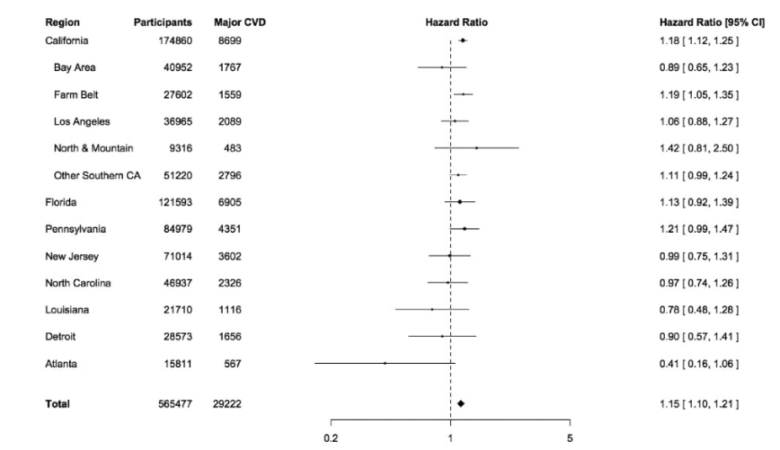
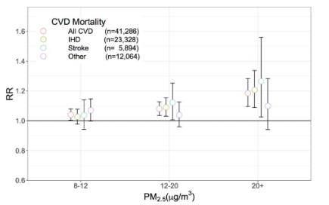
Results and Graph
Exposure to PM2.5 per 10 lg/m3 leads to 16% increase in IHD and 14% increase chance for stroke (14% increase)
PM2.5 and mortality due to IHD varies with Region.
California exhibits greater variation in PM2.5 association with health risks

Slide 9
Our Understanding
Various air particles substances and its impact on health
Time variant study on two different datasets such as air quality and diseases
Grouping features such as gender & age group, religion & ethnicity, and identify the impact on time variant model
Steps to follow for research, data collection etc.

Slide 10
Scope for Future Extension
Should consider different regions with different weightage based on season, climate and air quality
Other than Cox Regression, this experiment should have explored with any other regression models for comparative study
Notes:
This experiment is treated in various location, but the seasonal data was not considered in the analysis . Location such as California and New Jersey is treated with the same weightage. This should extend to treat the time and climatic conditons along with air quality

Slide 11
Our Project

Slide 12

Association between PM 2.5 levels and yearly respiratory infections in California
Presented by Team 7
- Again US!

Slide 13
Problem Statement
As global warming continues to heat up the world, the air quality becomes worse.
Worse air quality can potentially lead to respiratory problem
During our study we attempted to determine the correlation between the quality of air and the potential to be affected by respiratory diseases

Slide 14
Data Collection
Air Quality Data
Purple Air
California Government
Disease Cases
Asthma
Flu
Influenza
Pneumonia
Notes:
Purple Air: Station data, the graph shows an aggregated data view of all sensor data.
All Data shown for diseases is aggregation of the different sources that data was collected from.
Primiarly government sites, such as data.gov, cdc, etc.

Slide 15
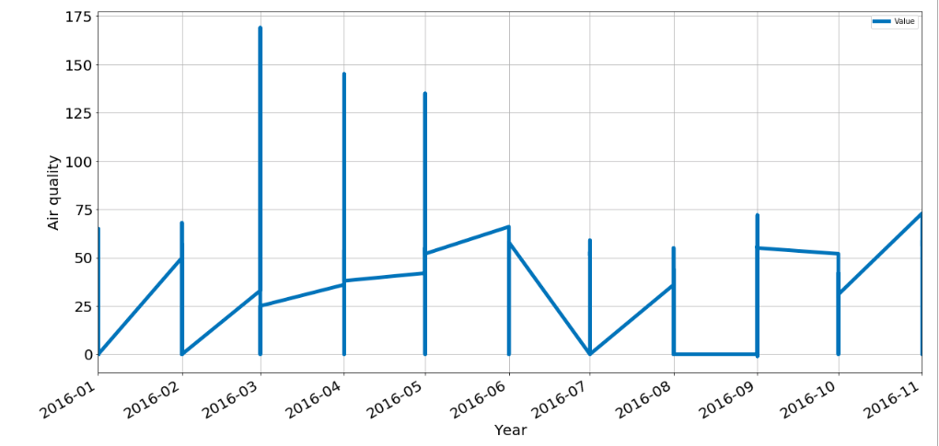
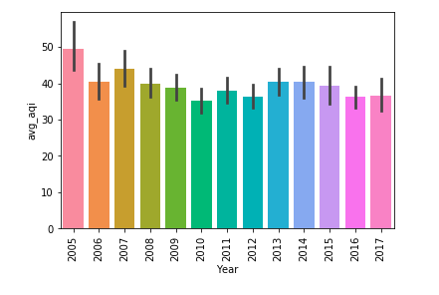
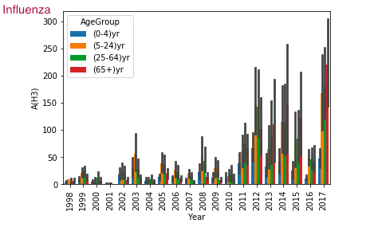
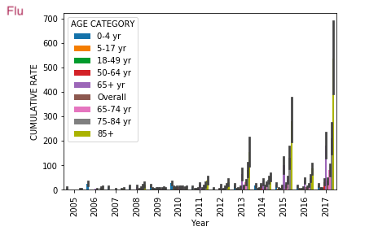
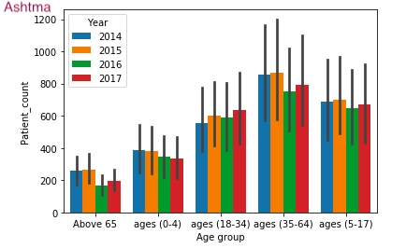
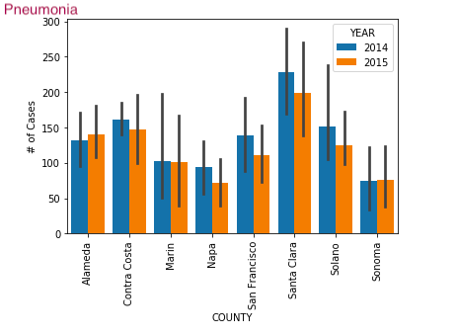
Data Preprocessing
Air quality data is collected from different sensors mounted in various counties( from purple air )
We preprocessed the json and convert to valid csv format
Disease data from web, is collected for various metrics such as Age group, gender, year are aggregated
Missing values for disease data is not uniform. Eg., Na, NULL, na
Removing special characters from data. Eg., hospitalization patient count is 12,345

Slide 16
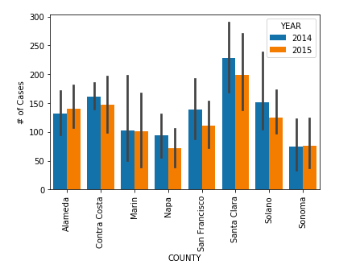
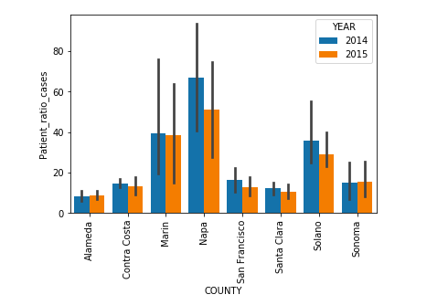
Data Transformation
Hospitalization data collected for each disease is the patient count
We have normalized the data across each county by the population of the county
Patient Ratio = Number of patients in a county / Total population of the county
Since the ratio was too low for few counties, we have multiplied 10000 to all ratio, to compute disease per 10000 people

Slide 17
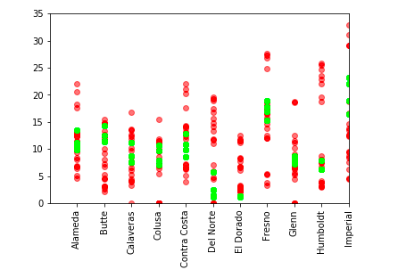
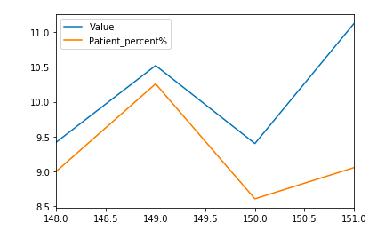
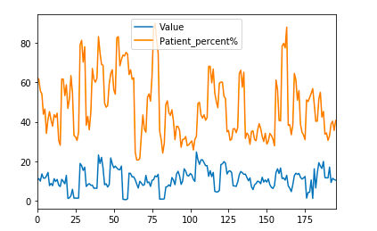
Data Integration
Merging air quality and disease data based on county and year
Few counties have linear relationship between air quality and disease
Graphs are the right implies Air quality and hospitalization ratio for multiple counties
Hospitalization trend with Air quality for a year
Hospitalization of one county with air quality

Slide 18
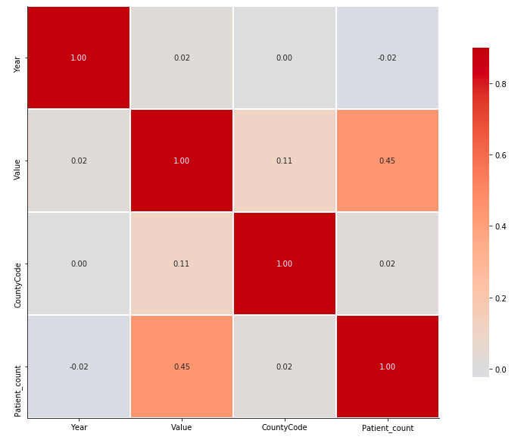
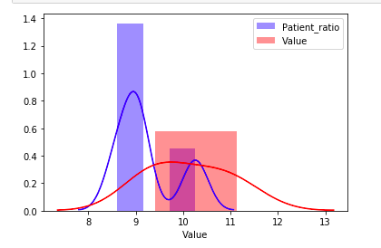
Data Interpretation
We have used seaborn graph to determine the correlation of features
We checked the variance of air quality and patient count for some counties to determine the relationship
Feature Selection: we applied L1 based feature selection using Linear regression.

Slide 19
Data Modeling
Linear Regression
L1 Regularization (Lasso)
L2 Regularization (Ridge)
Random Forest classifier
VAR Model
Code Walkthrough
PM2.5 Influenza Linear Regression
PM 2.5 Influenza Random Forest
Notes:
Our target variable is continuous , hence we tried using regression models
For the prediction , we applied linear regression.
After learning about regularization ,we applied L1- lasso and L2- Ridge regularization to improve the performance of model
Since we have historical data, we thought of using statistical model
We tried to compare the accuracy of our model with other models such as RF and DT

Slide 20
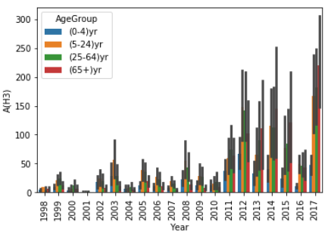
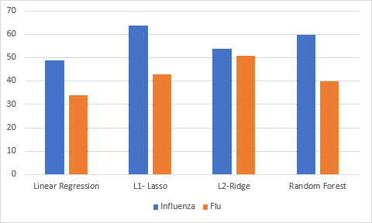
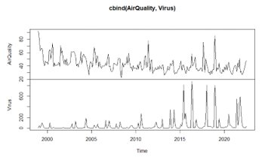
Results and Evaluation
We have followed various regression techniques to predict the hospitalization ratio from air quality.
From the last 10 years data , the prevalence of some virus has reduced.
The impact of the air quality on disease varies with age group

Slide 21
Technical difficulties
Availability of detailed data
Domain understanding
Mapping HIPS code to county code
Additional data download for data normalization

Slide 22
Key Learnings and Future Scope
Gathering large volume of data for regular time intervals
Properly bounding the problem is extremely important.
Domain expertise often required
Real-world is noisy and governed by multiple factors.
Extending the analysis to other air particles and ozone levels
Investigating the problem for different race and ethnicity and different seasons

Slide 23

Tools
Excel
Python
Matplotlib
Seaborn
Pandas
Numpy
Etc
Jupyter Notebook
Github
R Studio

Slide 24
Project Rubric
Data Collection | Data Reduction for quick demo | Volume | Velocity
Variety | Veracity | Version Control | Innovation
Visualization | Code Walkthrough | Q&A | Evalution of Performance
Presentation Skill | Report | Lesson Learned | Teamwork
Significance to the real world | Tool Usage (Use of big data tool ecosystem) | Prospects of winning competition/publication | Technical Difficulty

Slide 25
Q&A

Slide 26
Thank you

